Slide 1
ITMD 421 – Data Modeling and Applications
Aastha Gupta
Lecture 1
August 21, 2017

Slide 2
Objectives
Course Introduction
Introduction to databases
Overview of DBMS topics: key concepts, architecture and related terminology

Slide 3
About me
Name: Aastha Gupta
Phone: (857) 453-0107
Email: agupta56@iit.edu
Office hours:
Rice Campus: Wednesday 10-12 pm, by appointment
Main Campus: Before class, by appointment
Google Hangout, on request.
Email:
Please begin subject line with “ITMD 421”

Slide 4
Blackboard
Course Website
www.blackboard.iit.edu

Slide 5
Couse Grading
Grading
25% weekly assignments
25% midterm exam (take home)
25% Final Project
25% final exam (in class exam)
HW late policy
10% per late day, up to three days (then -100%)

Slide 6
Academic Honesty
Read IIT Academic Integrity Policy
1st Offense: 0 for offending assignment, academic honesty violation filed with department
2nd Offense: E for the entire course, academic honesty violation filed with department – you may be dropped from the program

Slide 7
Disabilities
To the best of my ability I pledge to make sure anyone with a disability is given equal chance to excel in this course.
Students must obtain a letter of accommodation from the Center for Disability Resources and make an appointment to speak with me to communicate your requirements as soon as possible

Slide 8
Course Text
Lecture slides cover essential material
Textbook:
Fundamentals of Database Systems, 7th Edition Ramez Elmsari, ISBN-13: 978-0136086208
Learning SQL: Mastering SQL Fundamentals, O’Reilly, 2nd Edition ISBN-13: 978-0596520830
Other material posted as needed

Slide 9
Course Requirements
Web browser
Install Chrome or Firefox
Text editor
Notepad++, Sublime Text
MySQL
Install MySQL community server
Version 5.7.19
Download link: https://dev.mysql.com/downloads/mysql/
SQL Developer
Install Oracle SQL developer
http://www.oracle.com/technetwork/developer-tools/sql-developer/downloads/index.html

Slide 10
Tips for success
Largely what will determine what you get out of this course is by your own research
I will guide you through the world of database– but I encourage you to branch out, read ahead.
If in doubt –
Google the problem
Send me an email

Slide 11
Participation Confirmation
One time attendance “confirm participation”
Post on discussion forum
Email me
Questions?

Slide 12
The world is increasingly driven by data…
This class teaches the basics of how to use & manage data.

Slide 14
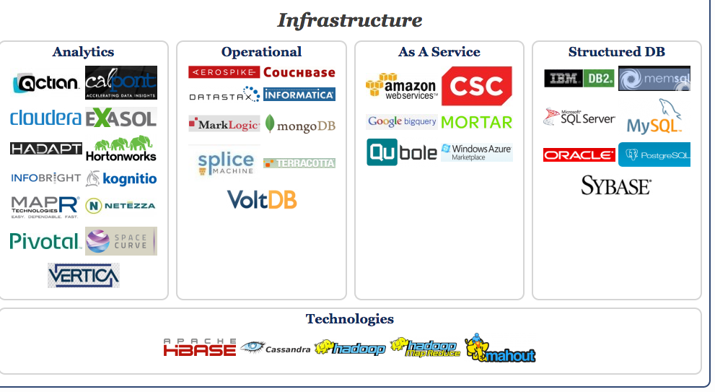
Big Data Landscape… Infrastructure is Changing

Slide 15
What the course is about
Discuss fundamentals of data management
How to design databases, query databases, build applications with them.
How to debug them when they go wrong!
Not how to be a DBA or how to tune Oracle 12g or MySQL
We’ll cover how database management systems work

Slide 16
Why should you study databases?
$$$:
Startups need DB talent right away = low employee #
Massive industry…
Intellectual:
Science: data poor to data rich
No idea how to handle the data!
Fundamental ideas to/from all of CS:
Systems, theory, AI, logic, stats, analysis….

Slide 17
What is data?
Data is information that needs to be recorded. These are facts related to objects in consideration.
Name, Age, Date of Birth are examples of data related to a person.
Student Name, Student ID, Course Number, Address, Phone Number are examples of data related to a university.

Slide 18
What is a database?
A database is a systematic or organized collection of logically related data.
Organizations store data in different formats on various media like
Hard copy in a filing cabinet
Data in electronic spreadsheet
Or in databases

Slide 19
What is a database?
Properties of a database:
Persistent – data is stored on a stable medium
Shared – has multiple uses and interested users
Inter-Related – forms a bigger picture

Slide 20
Database Management System
A database management system (DBMS) is a collection of programs or software components which enable users to
define the database
construct the database
manipulate the data
share or retrieve data
maintain the database
and control access to the data

Slide 21
Database Management System
Database and DBMS software together form a database system.
DBMS was first implemented in 1960s.
First DBMS in history was implemented by Charles Bachman (Integrated data store)
Examples of DBMS: Oracle, MS Access, MySQL, SQL Server.

Slide 22

Database System
Database Application
User
Database Management System (DBMS)

Slide 23
Drawbacks of file-system
Early data processing systems used files of data in text form
Problem: this led to
Data isolation
duplication of data
excessive time for development and maintenance
Application program dependency

Slide 24

Need for DBMS
Data Storage
Data Retrieval
Data Storage
Data Retrieval

Slide 25
Retrieval Problems
Data retrieval: Declarative
Find the students (names) who took ITMD 421
Find the students with GPA > 3.5
For every query we would need to write a program!
Want database retrieval to be:
Easy to write
Executed efficiently

Slide 26
Data Integrity
Data integrity is the overall completeness, accuracy and consistency of data.
The following three integrity constraints are used in a relational database structure to achieve data integrity.
Entity Integrity
Referential Integrity
Domain Integrity
The concept of data integrity ensures that all data in a database can be traced and connected to other data.

Slide 27
Data Integrity
Data Integrity in flat file (file system) model
Poor support for sharing:
Simultaneous modifications
Poor coping mechanisms for system crashes
No means of Preventing Data Entry Errors (checks must be hard-coded in the programs)
Security problems
Database systems offer solutions to all the above problems

Slide 28
Redundancy
Redundancy occurs when more than one record in a table stores the same information
Wastes space
Allows modification, deletion, and insertion anomalies
Normalization removes redundancy by identifying and removing functional dependencies

Slide 29
We discussed about file system and its drawbacks over DBMS. What do you think are advantages of DBMS?

Slide 30
Advantages of DBMS
Control Redundancy
Avoid inconsistency
Enforce data integrity
Data Sharing
Data Integration

Slide 31
Advantages of DBMS
Data Independence
Database Security
Atomicity
Provide concurrent access
Provide Backup and Recovery

Slide 32
DBMS Users
Database Administrators
Database Designers
End Users
A Well-Designed DBMS makes many people happy!

Slide 33
Types of DBMS
Hierarchical
a It employs parent-child relationship of storing data
Relational
c The data is organized as logically independent table.
Object Oriented
d It employs data program capability.
Network
b It employs many-to-many relationship for storing data.

Slide 34
Hierarchical DBMS
Rarely used now.
Employs the parent-child relationship of storing data
Structure is like a tree with nodes representing records and branches representing fields.

Slide 35
Network DBMS
Looks more like cobweb or interconnected network of records.
Parent-child relationship; however a child can have more than one parent.
Parents are called occupier and children are called members.
This supports many-to-many relationships

Slide 36
Relational DBMS
The data is organized as logically independent table.
Most popular and widely used
Example – Oracle, MySQL, MS Access
We work on RDBMS directly or through an application that supplies a interface.
(SQL Developer Vs Blackboard)

Slide 37
Relational DBMS
First introduced by Edgar F. Codd in 1970
Data is made up of two-dimensional tables called relations.
Relationships between tables are given by shared keys.
Rules exist for dividing data among tables
A standardized query language (SQL)

Slide 38
Relational Model Example
Attributes
Student ID- | Student First Name | Student Last Name | Student EmailId | Student Phone Number
A203467 | John | Smith | jsmith@iit.com | 785-524-2574
A679345 | Greg | Linton | glinton@iit.com | 457-789-1453
A452813 | Aastha | Gupta | agupta56@iit.edu | 143-781-2654
Records
This whole table is an instance of the Student schema.
Key

Slide 39
Relational Model Example
Each row of a relation is a tuple (or record), representing one instance of that entity
Each column of a relation is an attribute for which each tuple has a value assigned
Each attribute has a domain from which its values are taken
A domain consists of atomic values – no multi-valued or divisible attributes are allowed
Missing/unknown values are indicated by NULL

Slide 40
Relation Schema
A relation schema of consists of the name of a relation followed by a list of its attributes
e.g., STUDENT(ID, FirstName, LastName)
Each attribute must have its domain specified
e.g., ID is a seven-digit number, FirstName and LastName are both strings of length at most 20
Can also be represented graphically as a row of rectangles, one for each attribute

Slide 41
Schema VS Snapshot
The schemas describe the structure of the database, but do not tell us what is in it. It is the process of defining the database.
The particular data stored in the database at some point in time make up a snapshot (or database state). It is the process of populating the database.

Slide 42
Object Oriented RDBMS
It provides data program capability.
They use objects.
Each object consists of 2 elements –
Data
Methods

Slide 43
Data Abstraction
It is one of the major features of database systems.
Data Abstraction is hiding the irrelevant details from the user and providing an abstract view.

Slide 44

Data Abstraction
Physical Level
Lowest Level
How data are stored
Data Structure
Logical Level
Next higher Level
What data are stored
Describe in terms of small numbers
Used by DBA
View Level
Highest Level

Slide 45
Data Abstraction Tier
External level
This describes the end user of the data.
The end user interacts with the system through a graphical interface and is not aware where the actual data resides.
Different users can have different views of the data displayed.

Slide 46
Data Abstraction Tier
Conceptual level
This describes structure of the database but hides the details of the physical storage of the data.
This level describes the entities, relationships, data types and constraints.
Database Administrators work on this level

Slide 47
Data Abstraction Tier
Physical level
This constitutes the actual storage of the data in the database with their access paths.

Slide 48
Data Independence
Applications do not need to worry about how the data is structured and stored
Data is independent but mapped to each other.
Logical data independence
Physical data independence

Slide 49

Data Independence
Logical Data Independence
Logical Schema
Physical Schema
Physical Data Independence

Slide 50
Logical Data Independence
Logical Data is the data about database – it stores the information about how the data is managed inside.
Schemas are logical

Slide 51
Physical Data Independence
Schemas are logical; actual data is stored on disks in the bit format.
It refers to modifications in the physical without impacting the logical part.

Slide 52
DBMS Keys
Keys play an important role.
Establishes relationship among tables.
Identifies unique rows from the table.
Types of Keys
Primary Key
Super Key
Candidate Key
Alternate Key
Composite Key
Foreign Key

Slide 53
Constraints
These will be maintained by the DBMS:
Domain constraints: All values of each attribute must come from the specified domain
Entity integrity: No attribute in a primary key can contain a NULL value
Referential integrity: Every foreign key value must match the value of the primary key in some tuple of the table that it references
Custom constraints
E.g. account balance must be positive

Slide 54
Handling Violations
Operations that violate constraints are by default rejected, but there are other options:
Prompt user to change offending value(s)
Use default value in place of offending value(s)
Use NULL in place of offending value(s)
Allow operation, but cascade changes from primary keys to foreign keys as needed

Slide 55
DBMS Language
It is used to read, update and modify the data stored in the database
Language used - Structured Query Language
Data definition language
Data Manipulation language

Slide 56
Difference between Data definition language and Data Manipulation language

Slide 57
Database Architecture
Two tier Architecture
Three tier Architecture

Slide 58

Two Tier Architecture
Client Applications
Two-Tier Architecture
Data Source

Slide 59
Two tier Architecture
The application program interacts directly with the database
Example : Metra ticketing system
Advantages:
Direct communication with the database.
With less number of users, the data is retrieved quickly
Easy to maintain and modify

Slide 60
Three Tier Architecture
Mostly commonly used
Three layers:
Presentation layer
Application layer
Database Layer

Slide 61
Three Tier Architecture
Presentation Tier
Application Tier
Database Tier

Slide 62
Summary
DBMS are used to maintain, query, and manage large datasets.
Provide concurrency, recovery from crashes, quick application development, integrity, and security
Key abstractions give data independence
DBMS is one of the broadest, most exciting fields in CS. Fact!

Slide 63
Next Week
Conceptual Modeling
E-R model
Entities
Relationship
Attributes
There are no assignments for Week 1
THANK YOU!!

